Slide 1
Presentation on AROGYAM
Presented by: Guided by:
Sarang Rohankar(233082) Mrs.Gauri Kadam
Roshan Dahaghane(233074)

Slide 2
Introduction
The Talent on Tap project introduces a solution in the form of an on-demand home service application. This platform aims to bridge the gap between customers seeking a variety of home services and skilled professionals offering their expertise.
Customers gain the ability to effortlessly browse and book services suited to their needs, ensuring ease and convenience. Simultaneously, skilled professionals have a dedicated platform to showcase their services, manage appointments, and engage with customers effectively. The project's goal is to create an system that streamlines service delivery, enhances user experiences, and generate trust through transparent interactions.

Slide 3
Technologies Used
We used Java Spring-Boot as backend and React JS as Frontend in our Project.
Spring-Boot :–
The main goal of the Spring Boot framework is to reduce overall development time and increase efficiency.
React :–
React allows developers to create large web applications that can change data, without reloading the page. The main purpose of React is to be fast, scalable, and simple.

Slide 4


User Classes
Administrator
User
Professional
In this module admin can add professionals in system. Also admin can manage all professionals.
In this module user can see profile. User can book appointment for services. User can view reviews.
In this module professionals can add service, view profile. Professionals can approve appointments.

Slide 5
Functions
User Roles and Profiles
Service Listings and Exploration
Appointment Booking and Scheduling
Reviews and Ratings System
Appointment Management
Administrator Oversight

Slide 6
Admin module
Admin can approve professionals to be added.
Admin can view profiles.
Admin can delete professionals.
Admin can see existing professionals.

Slide 7
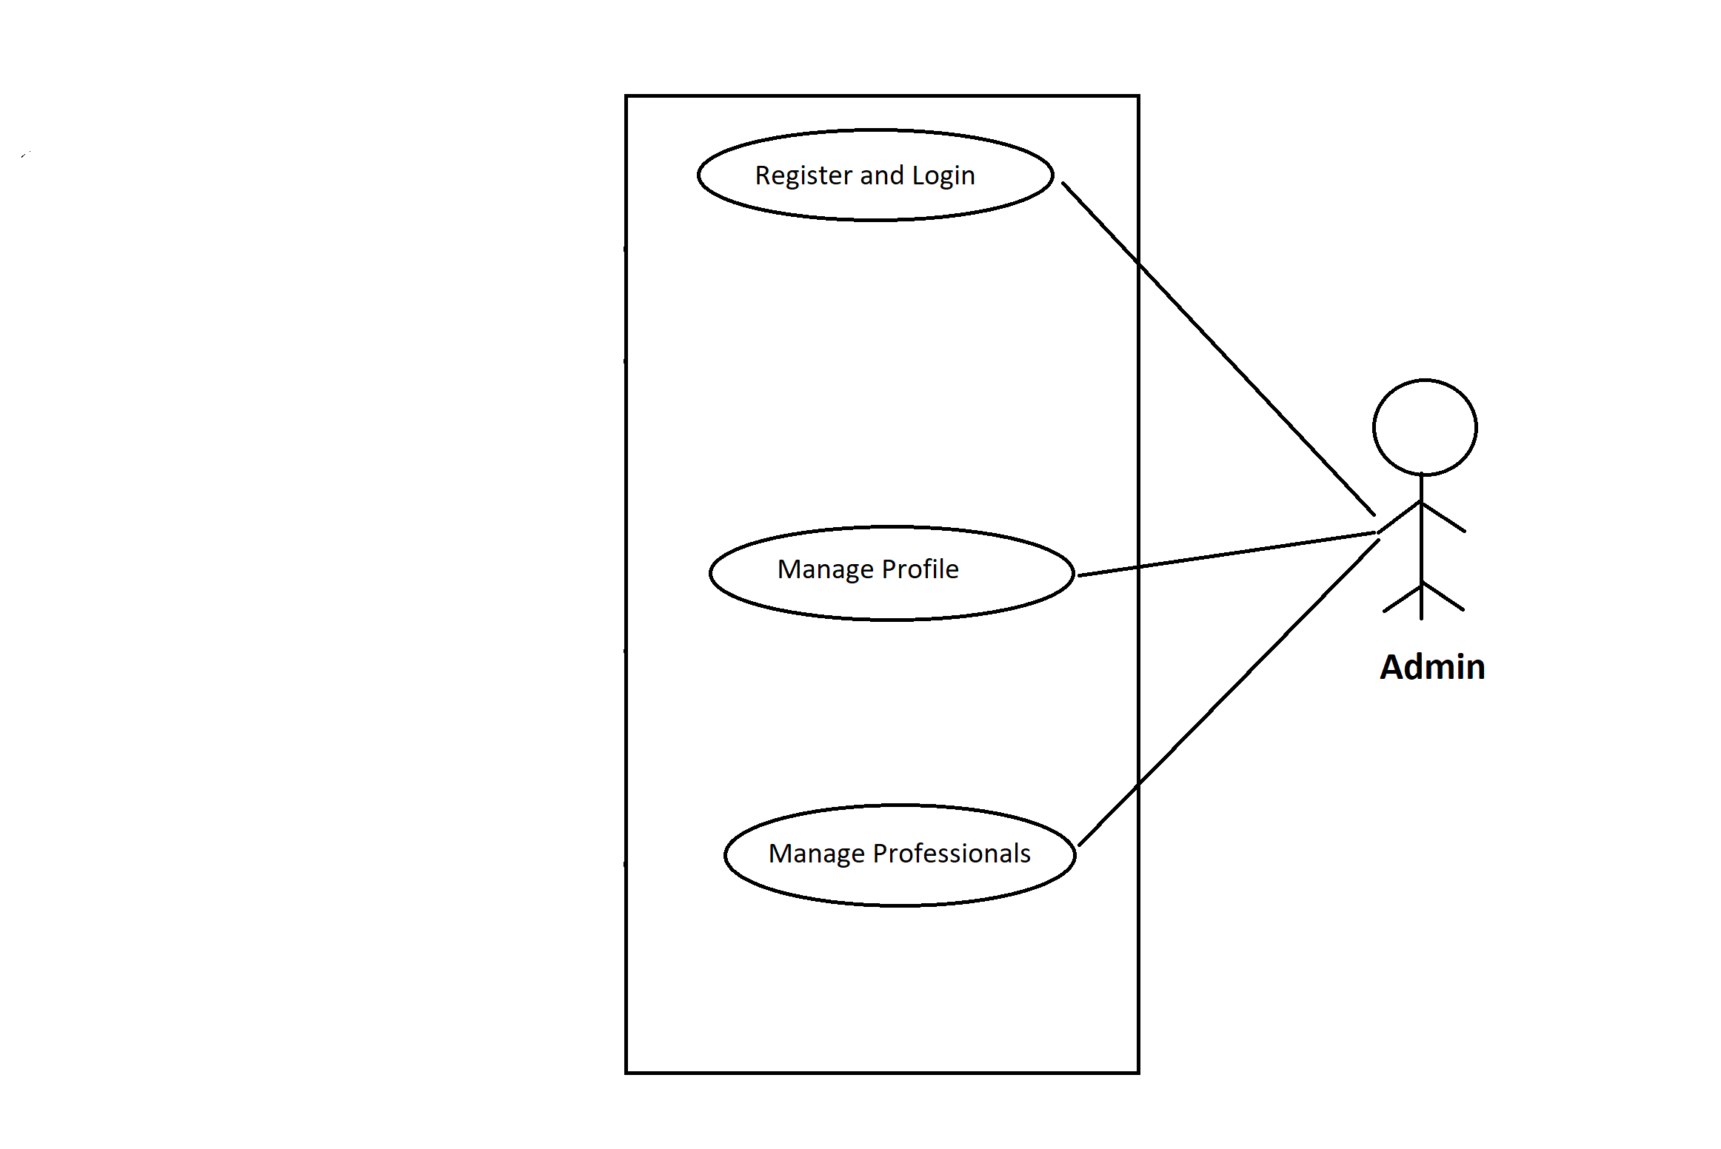
Use case diagram for Admin

Slide 8
User module
User can register and login with valid credentials.
User can book services via appointments.
User can view profiles of professionals.
User can view and manage their own profile.

Slide 9
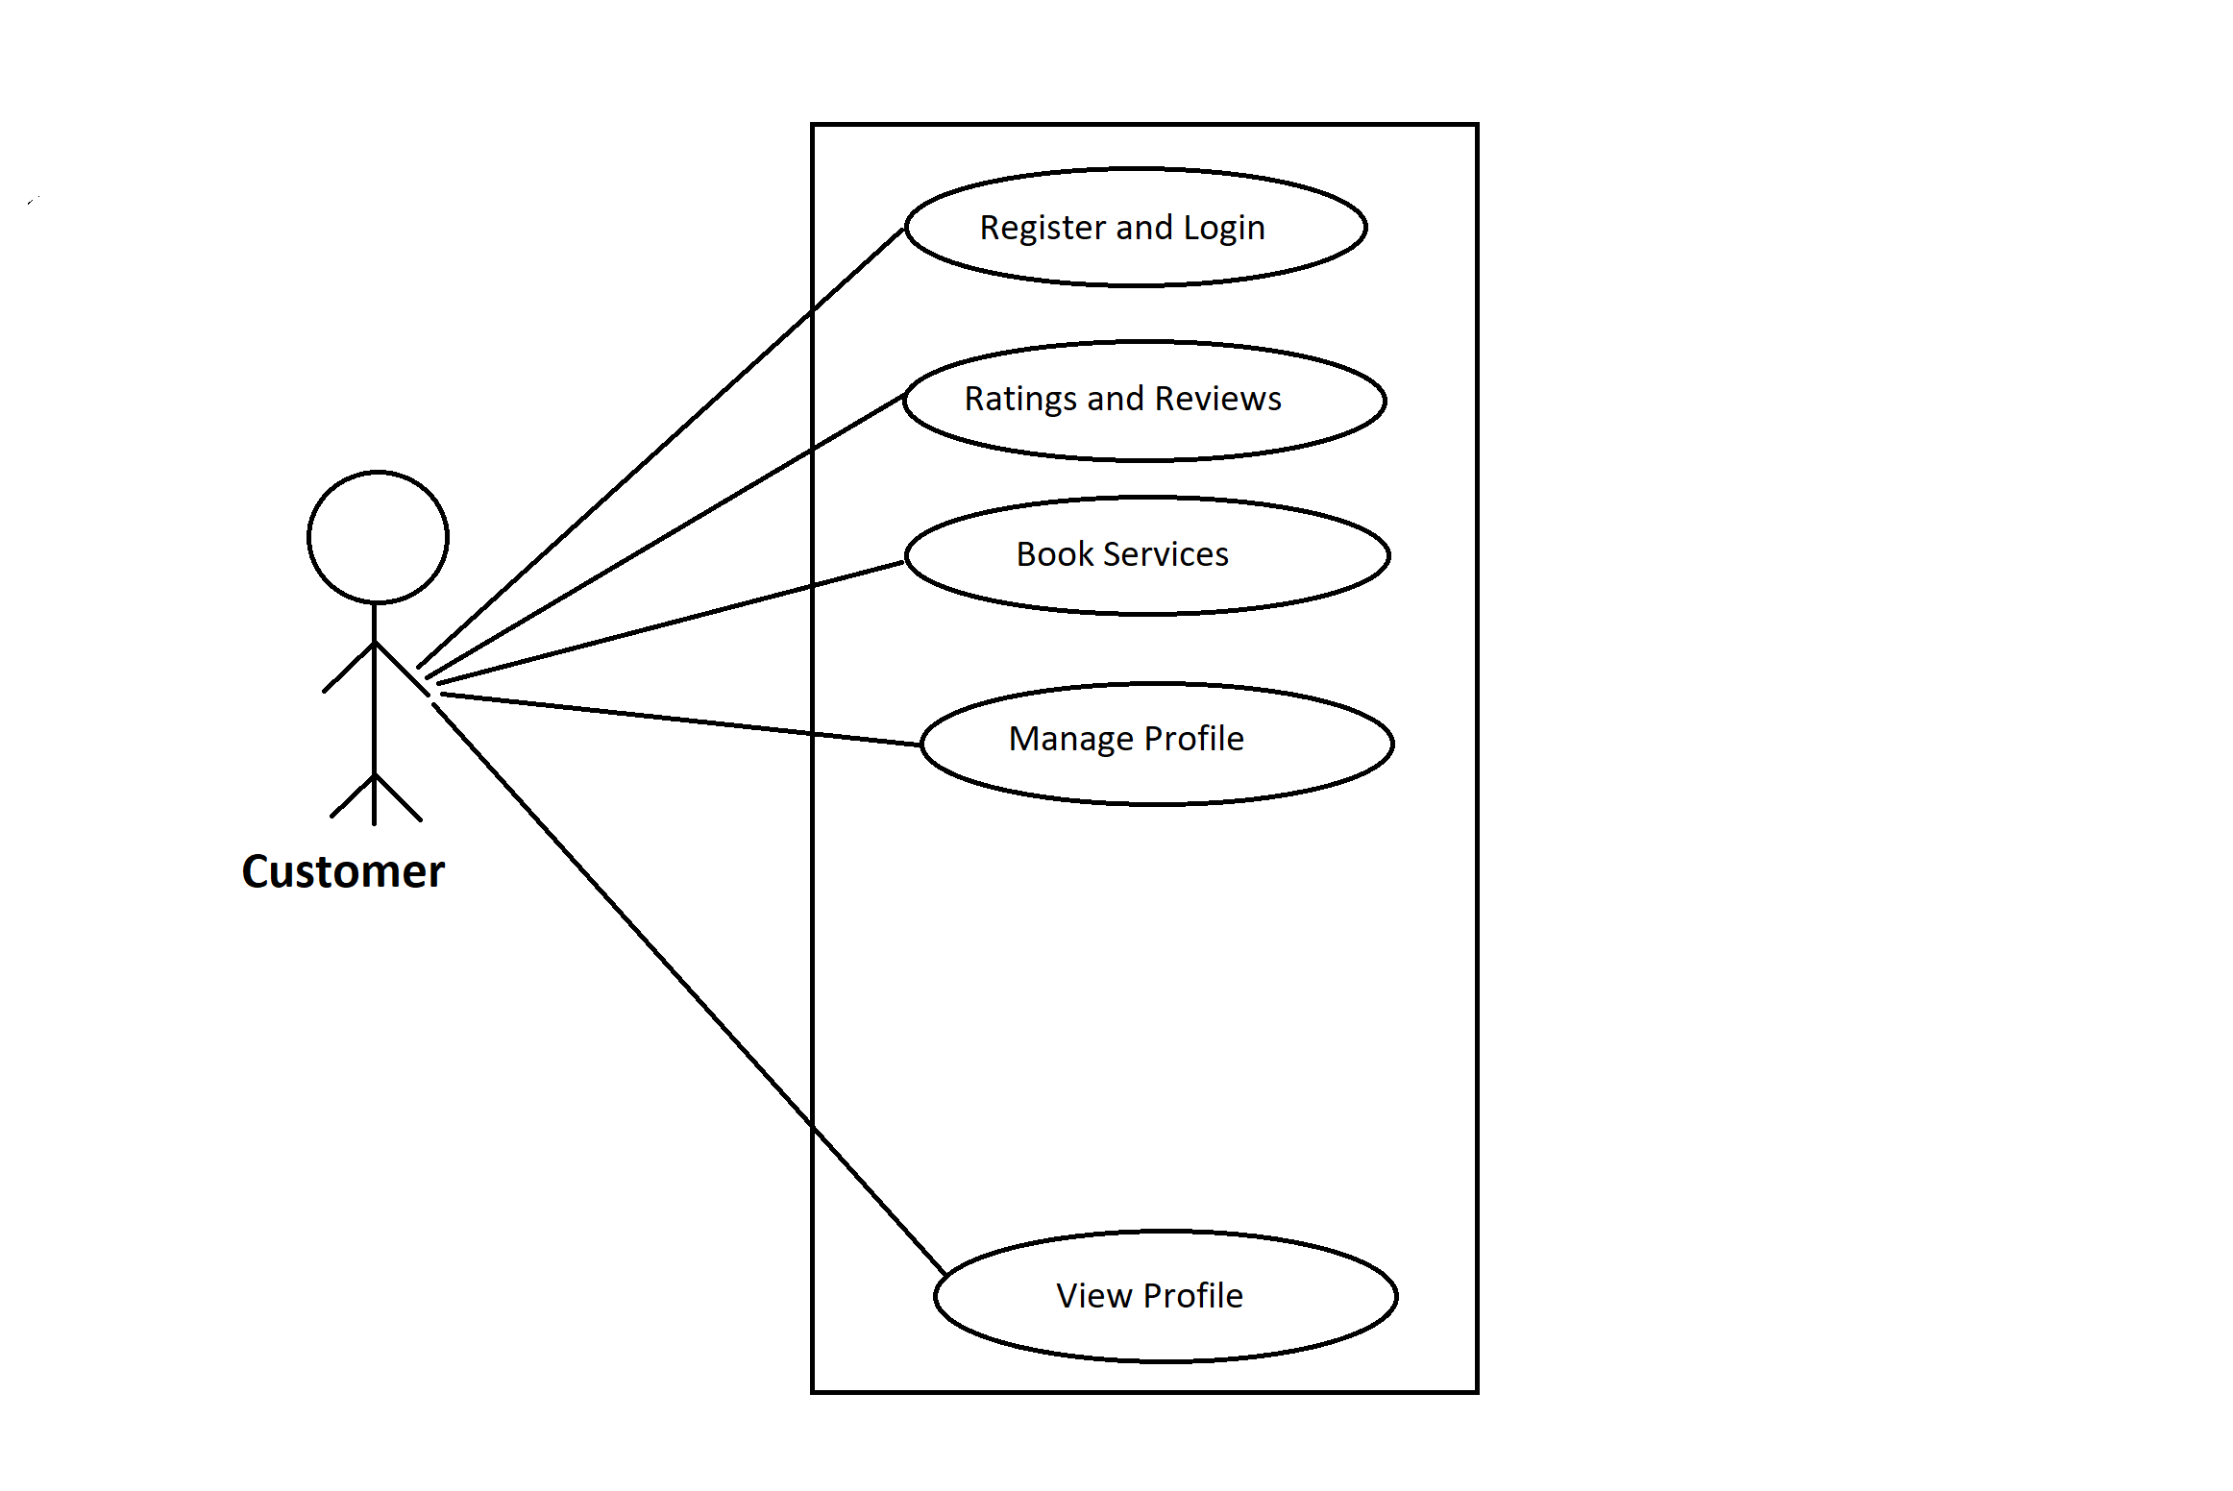
Use case diagram for User

Slide 10
Professional module
Professional can register and login using valid credentials.
Professionals can view profiles.
Professionals can manage profile.
Professionals can manage services.

Slide 11
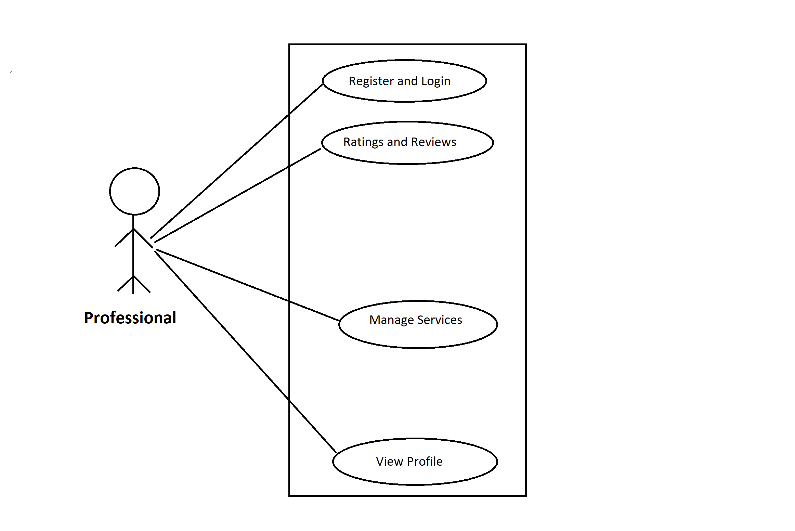
Use case diagram for Professionals

Slide 12
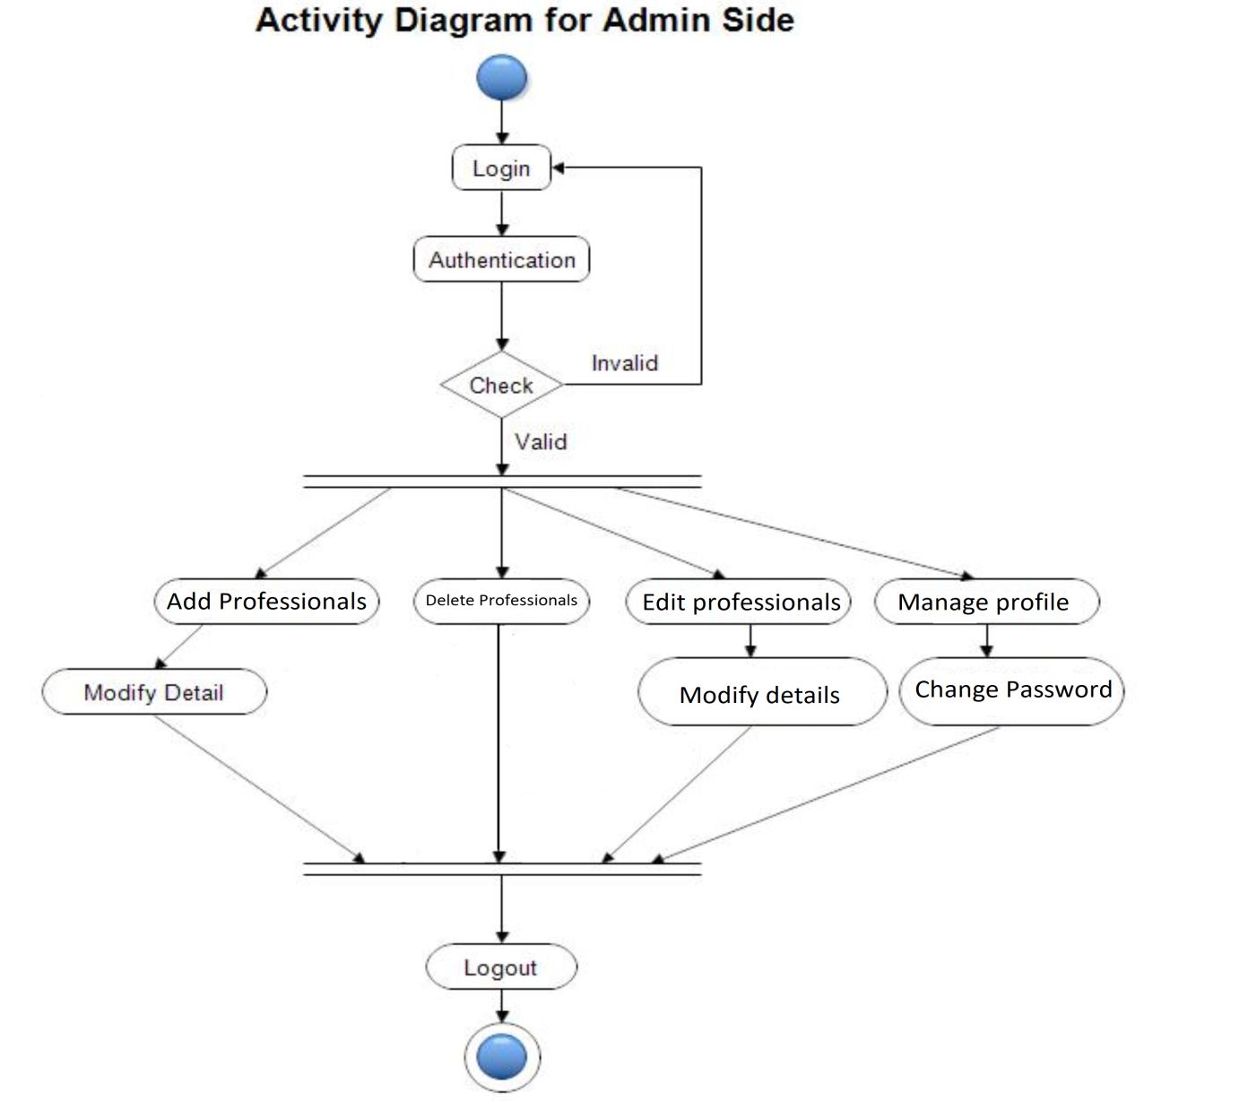
Activity Diagram: Admin

Slide 13
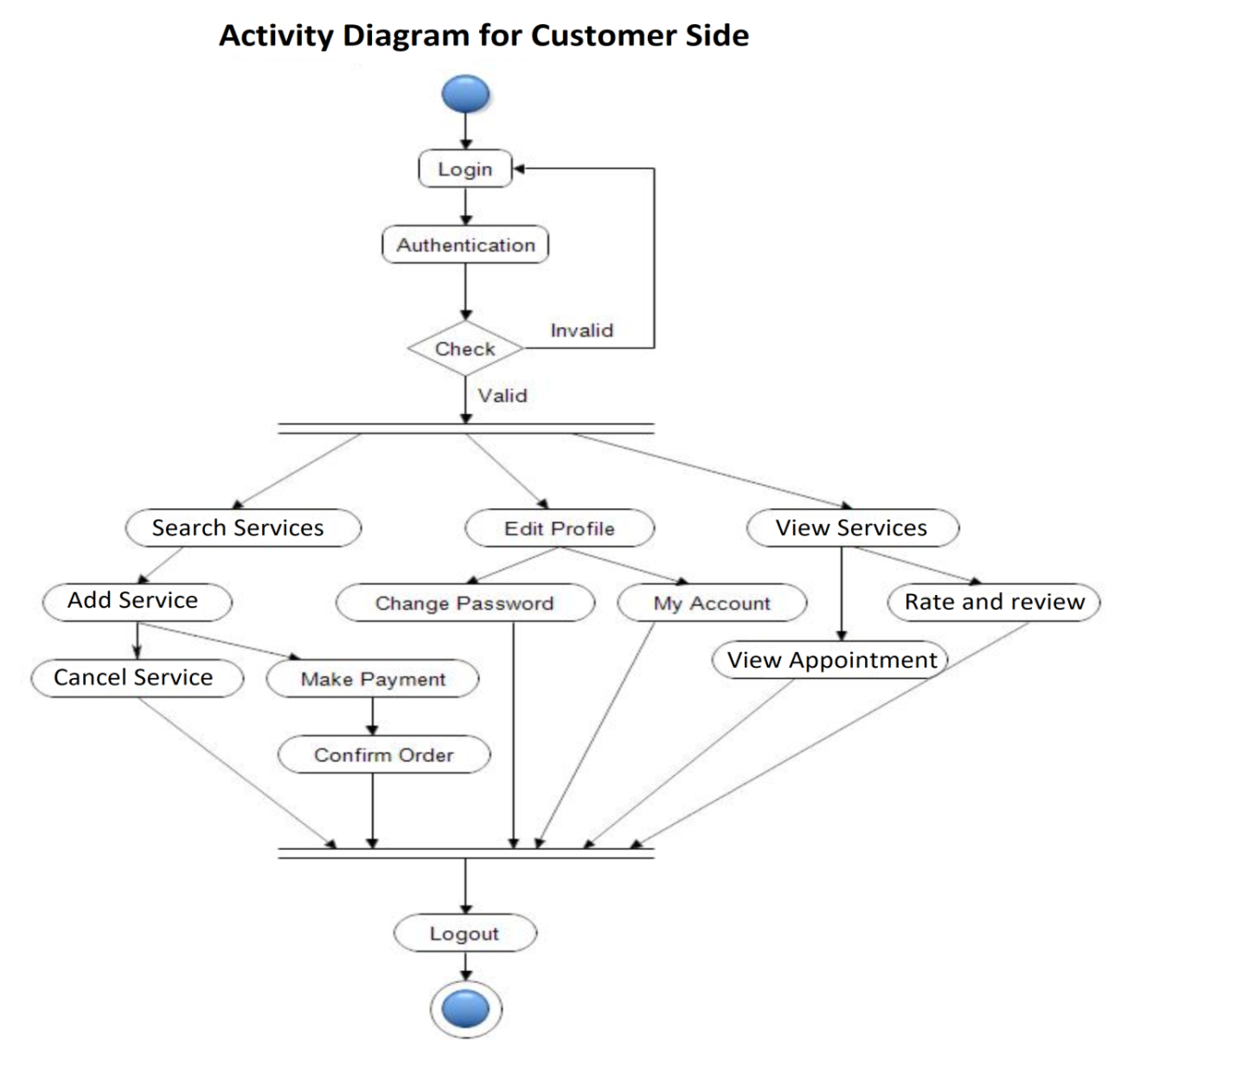
Activity Diagram: User

Slide 14
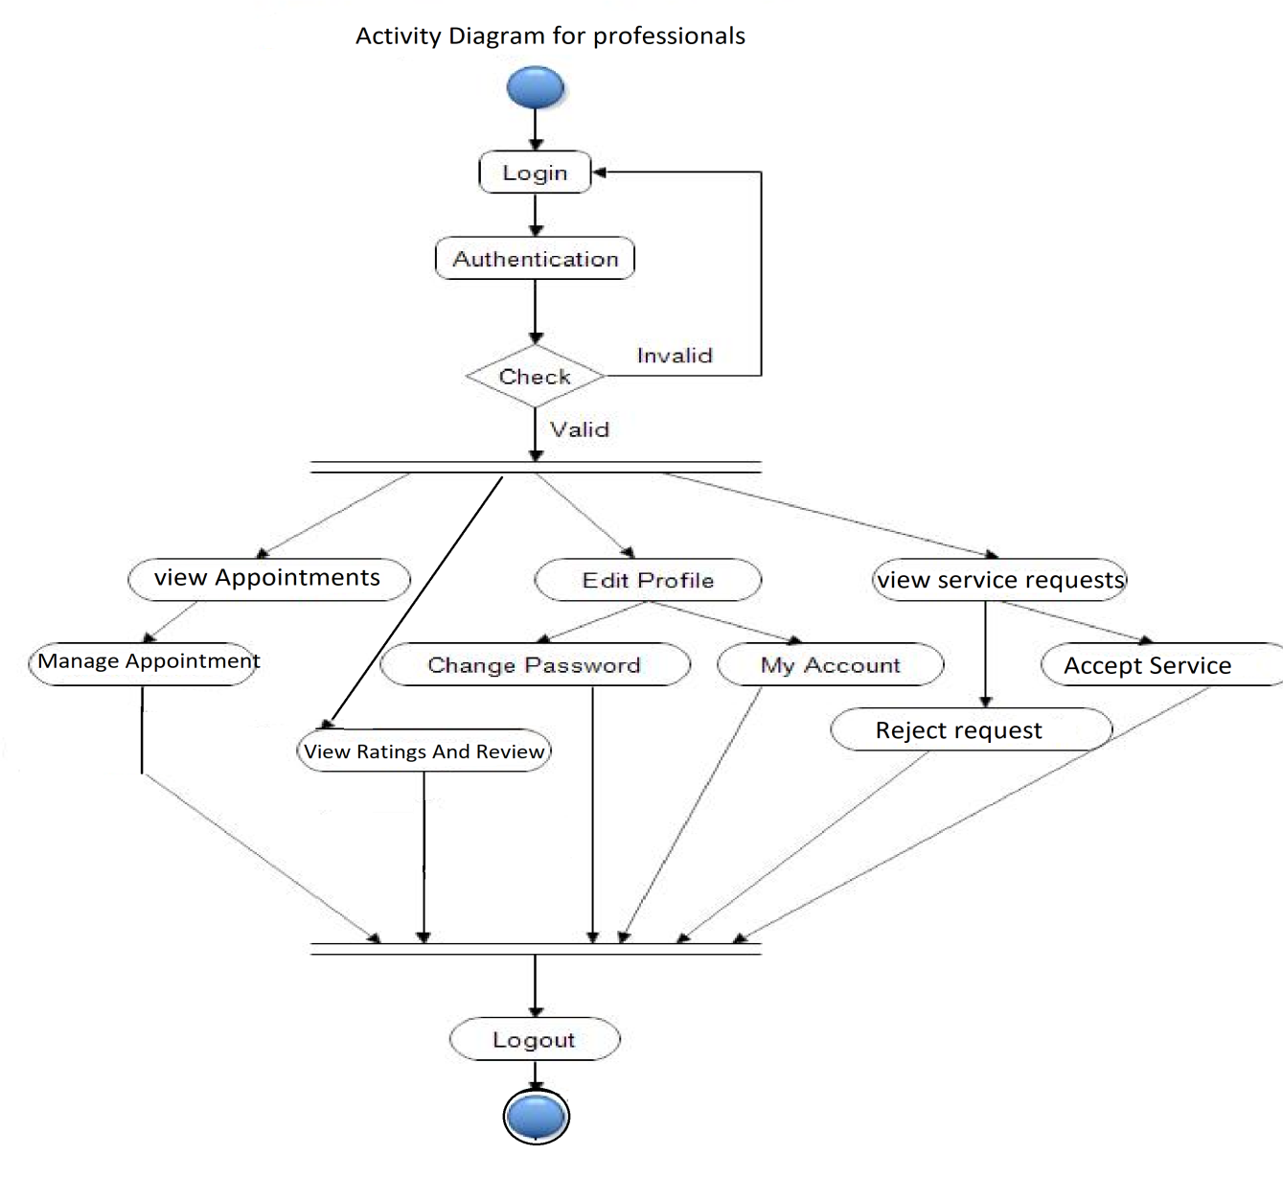
Activity Diagram: Professional

Slide 15
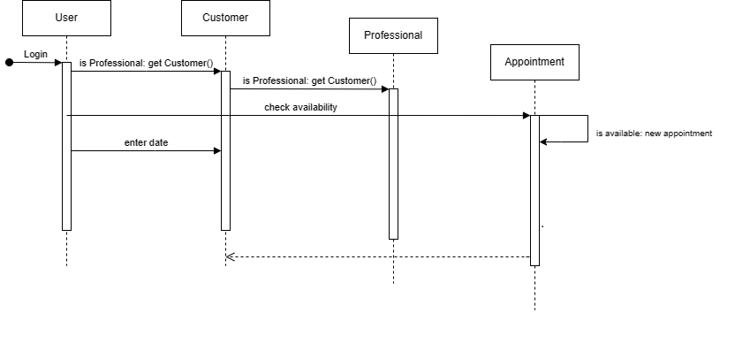
Sequence Diagram

Slide 16
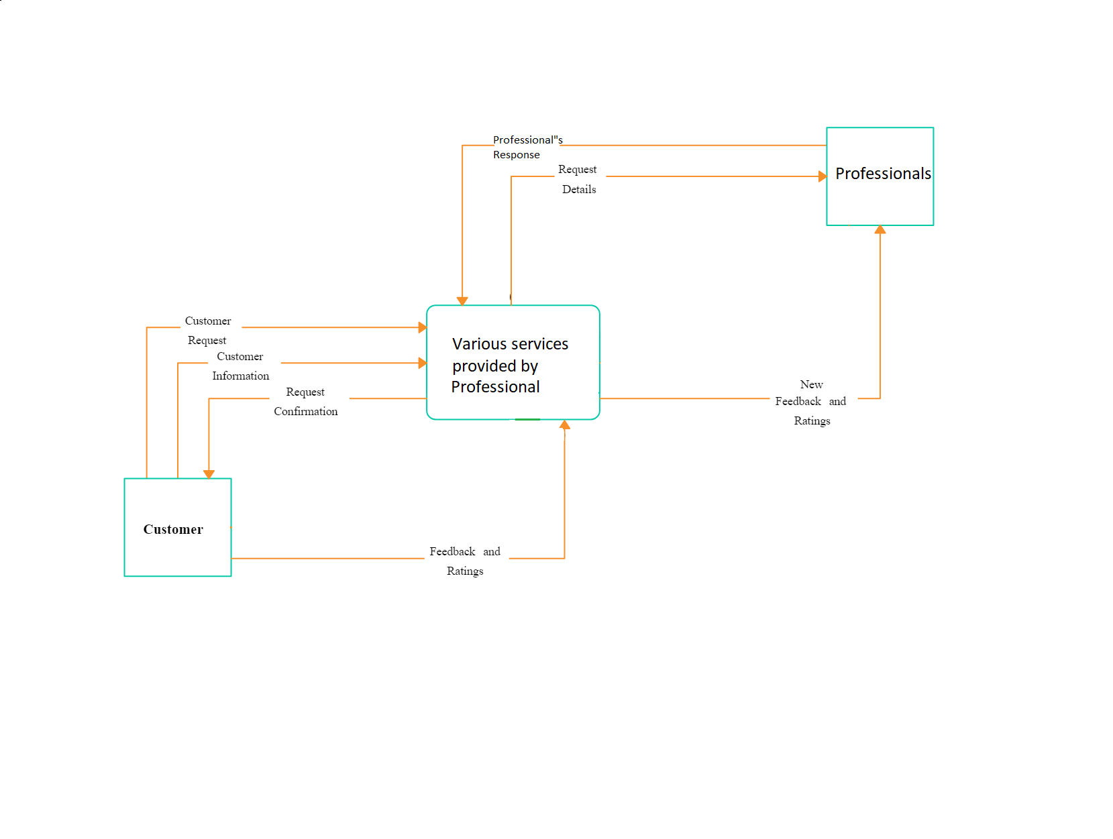
Data Flow Diagram

Slide 17
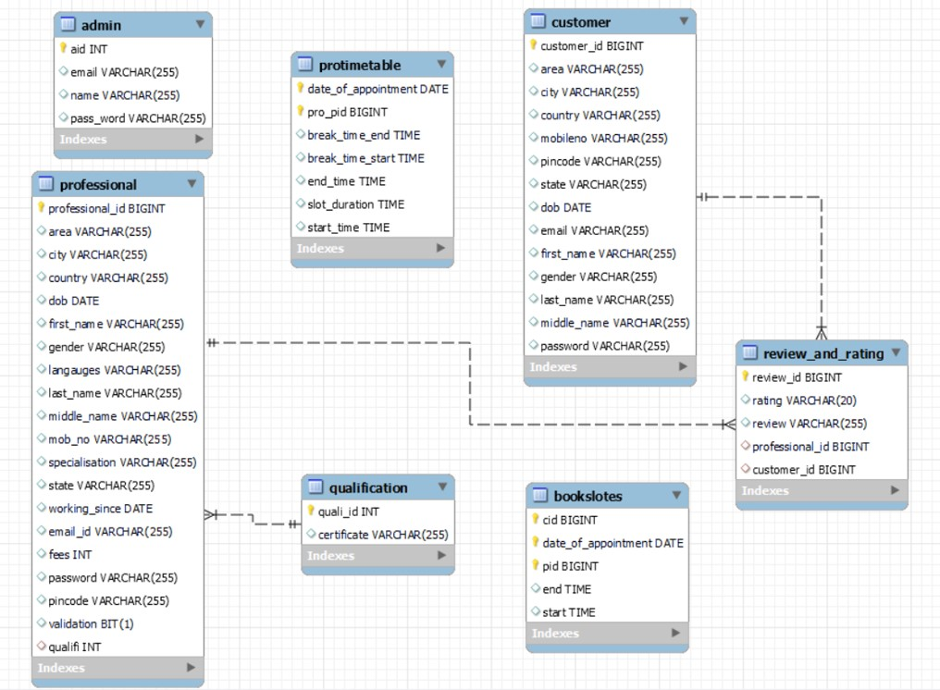
Class Diagram

Slide 18
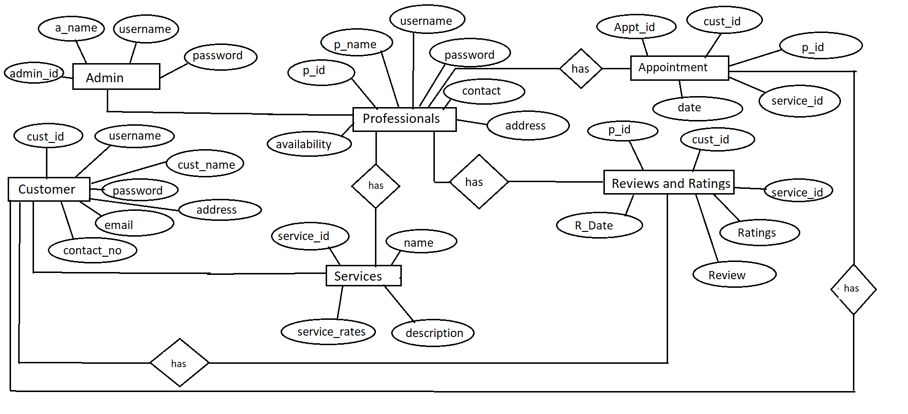
E-R Diagram

Slide 19
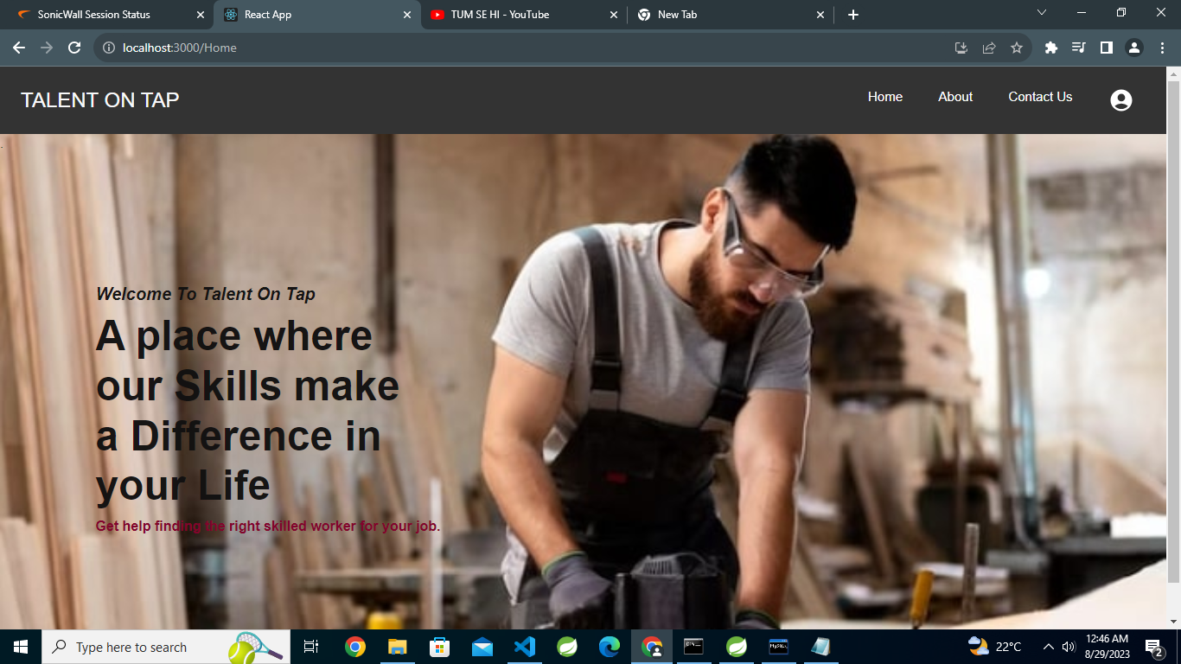
Screenshots

Slide 20
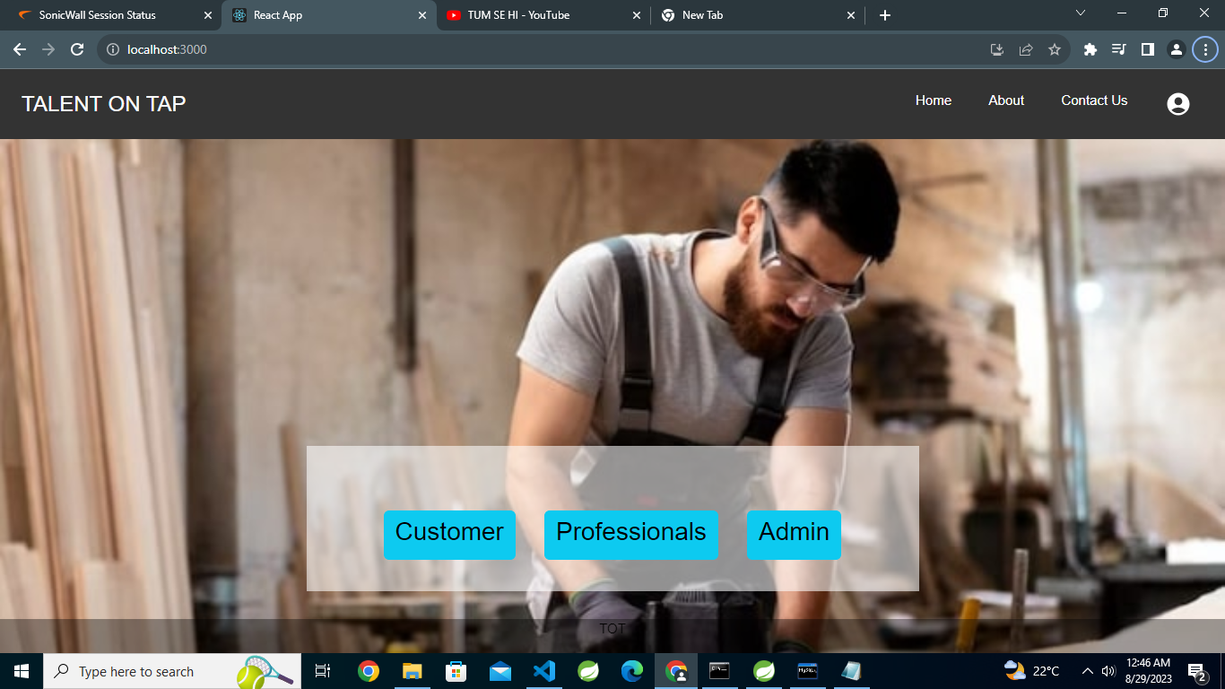

Slide 21
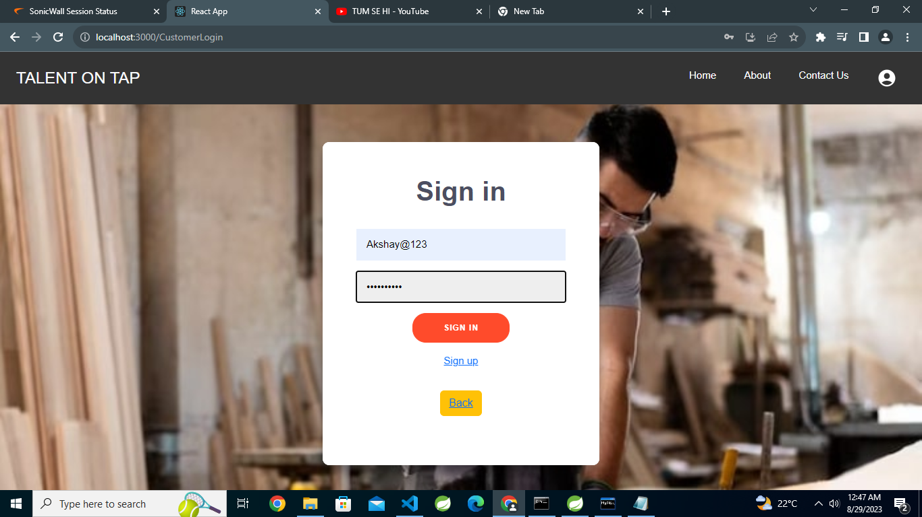

Slide 22
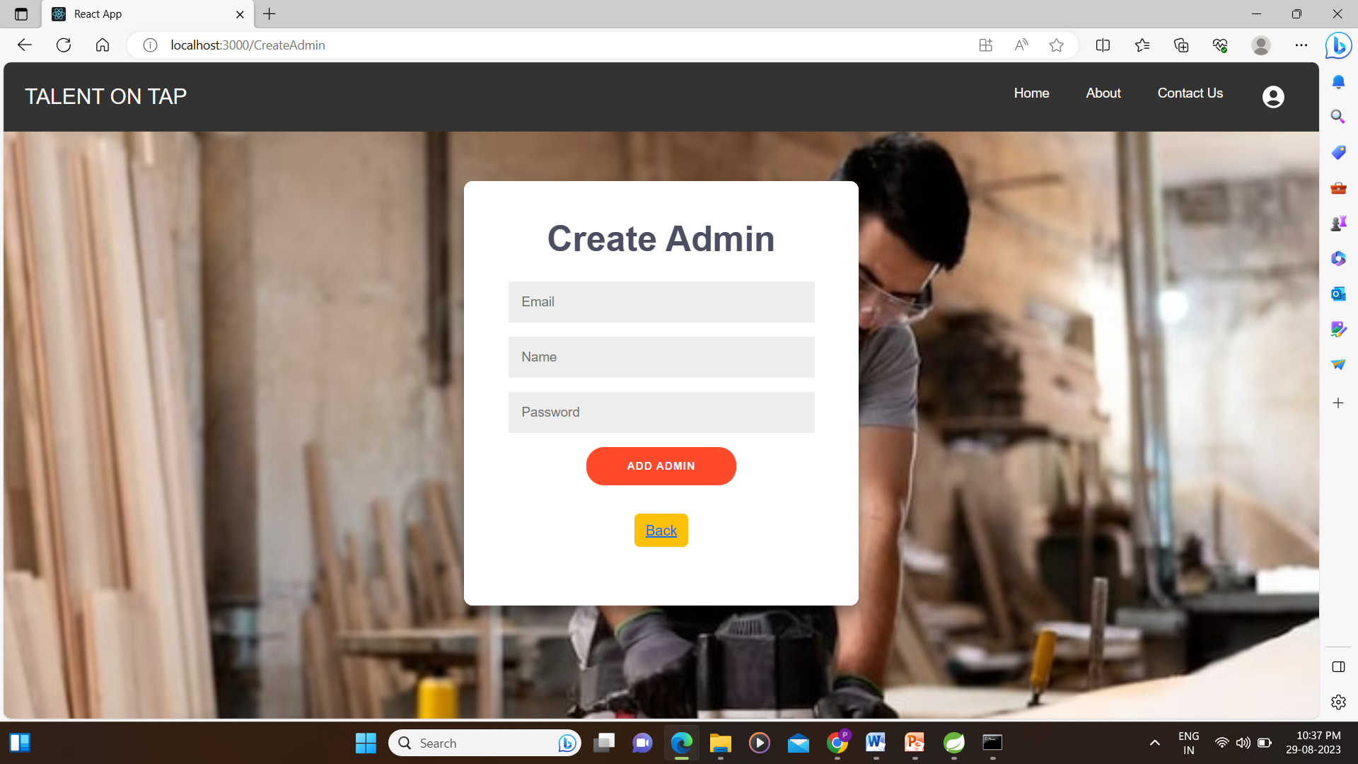
Admin :

Slide 23
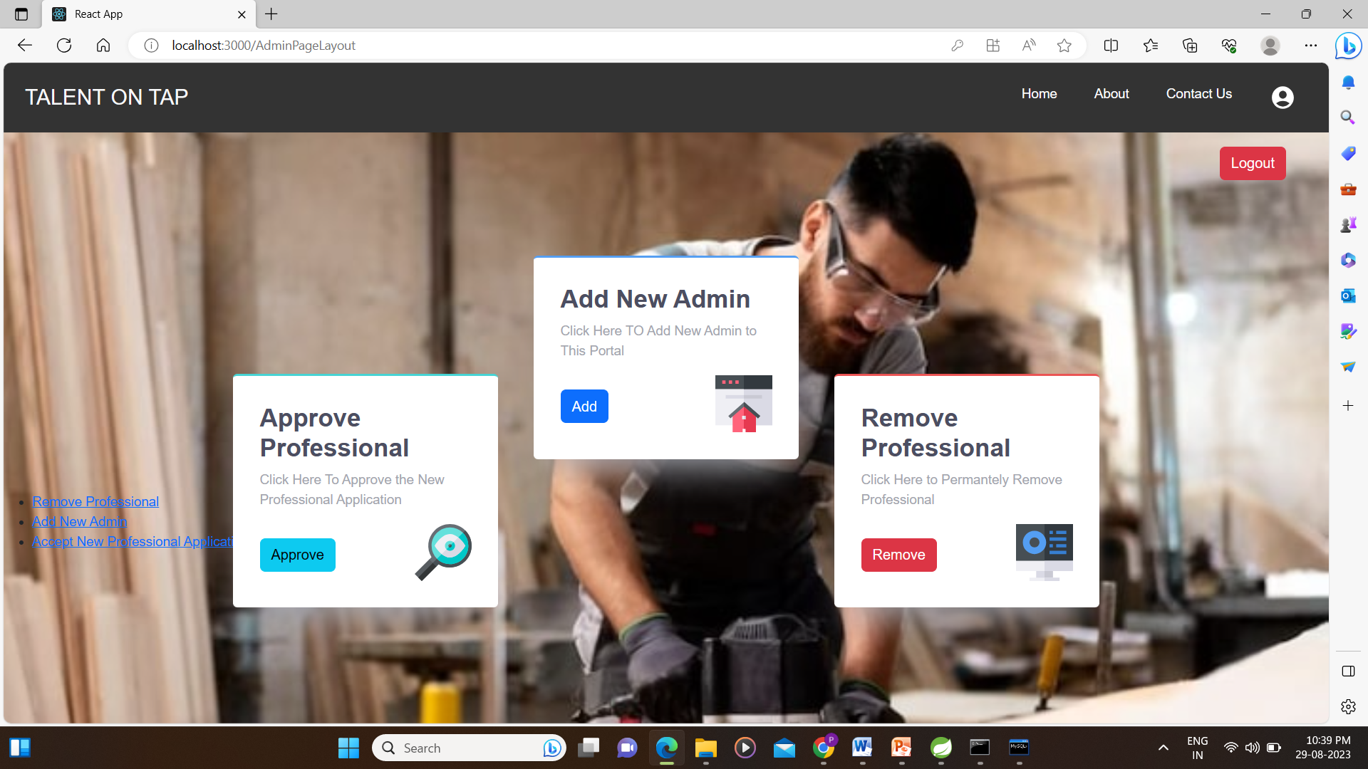

Slide 24
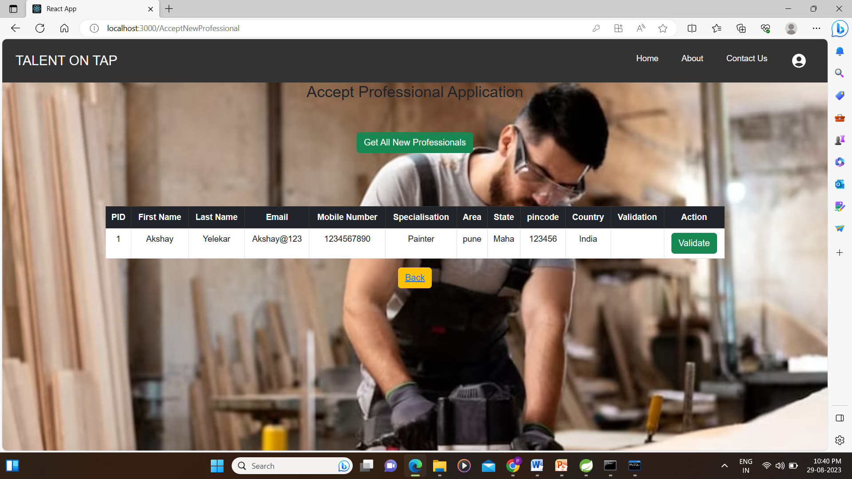
Approve Professional

Slide 25
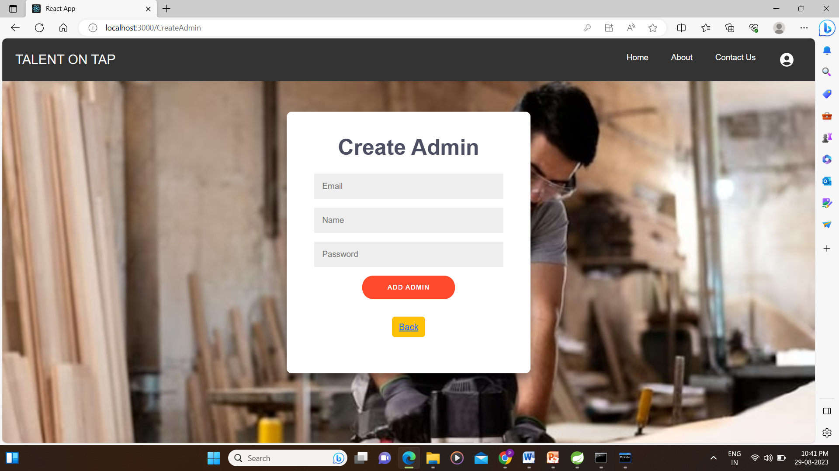
Add Admin

Slide 26
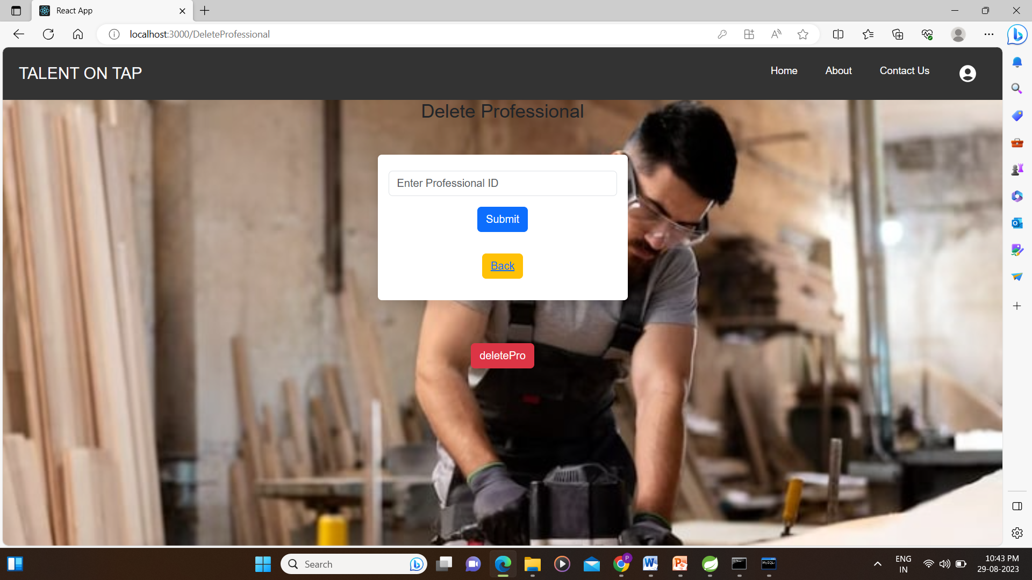
Delete Professional

Slide 27
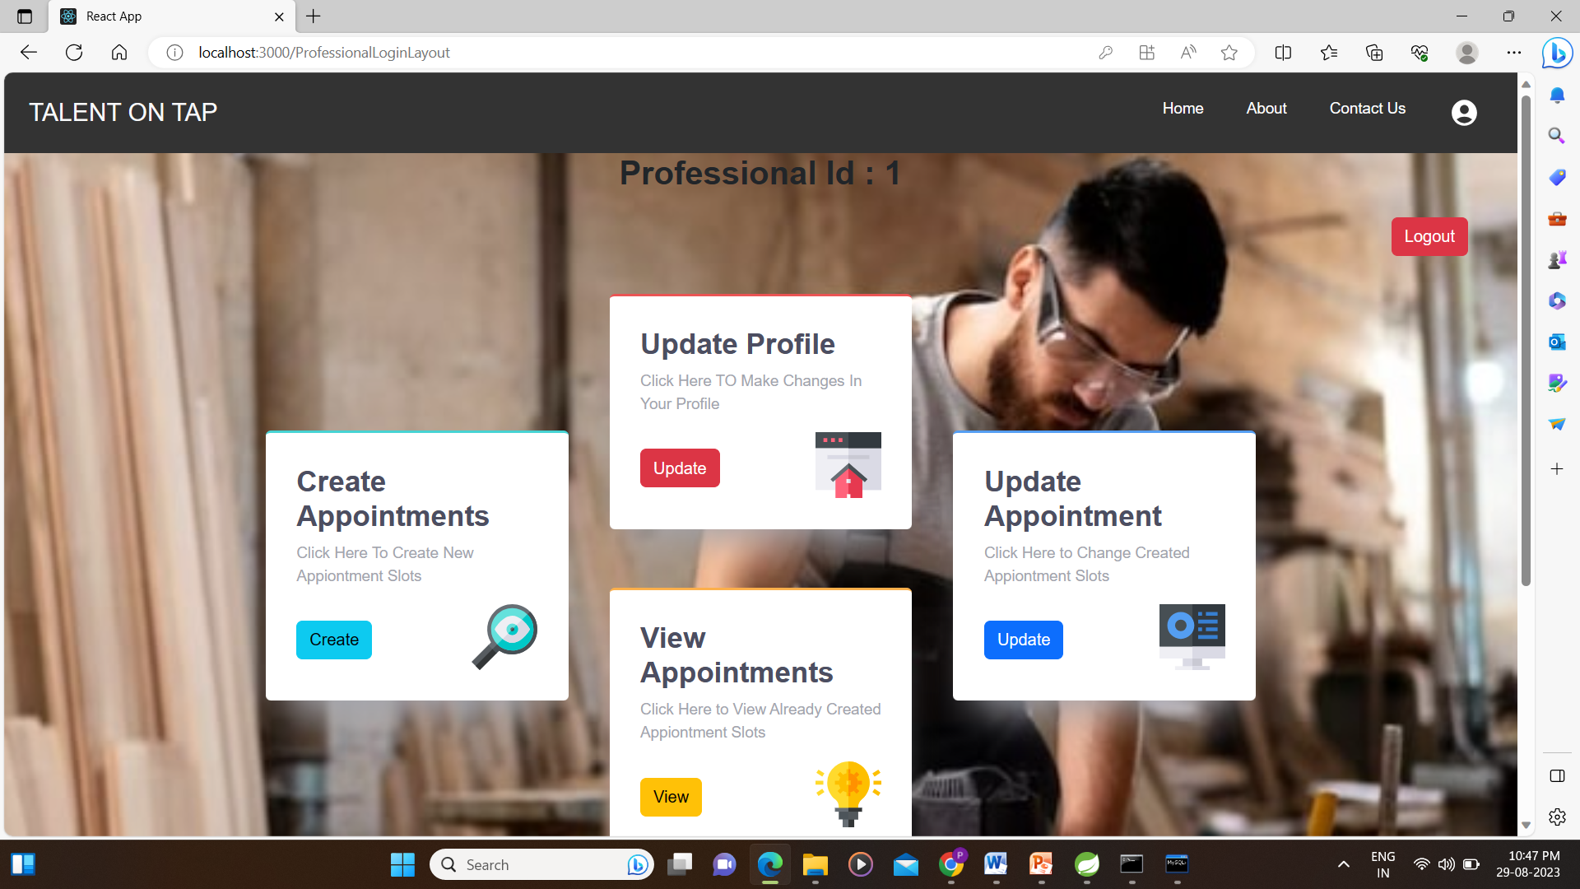
Professionals :

Slide 28
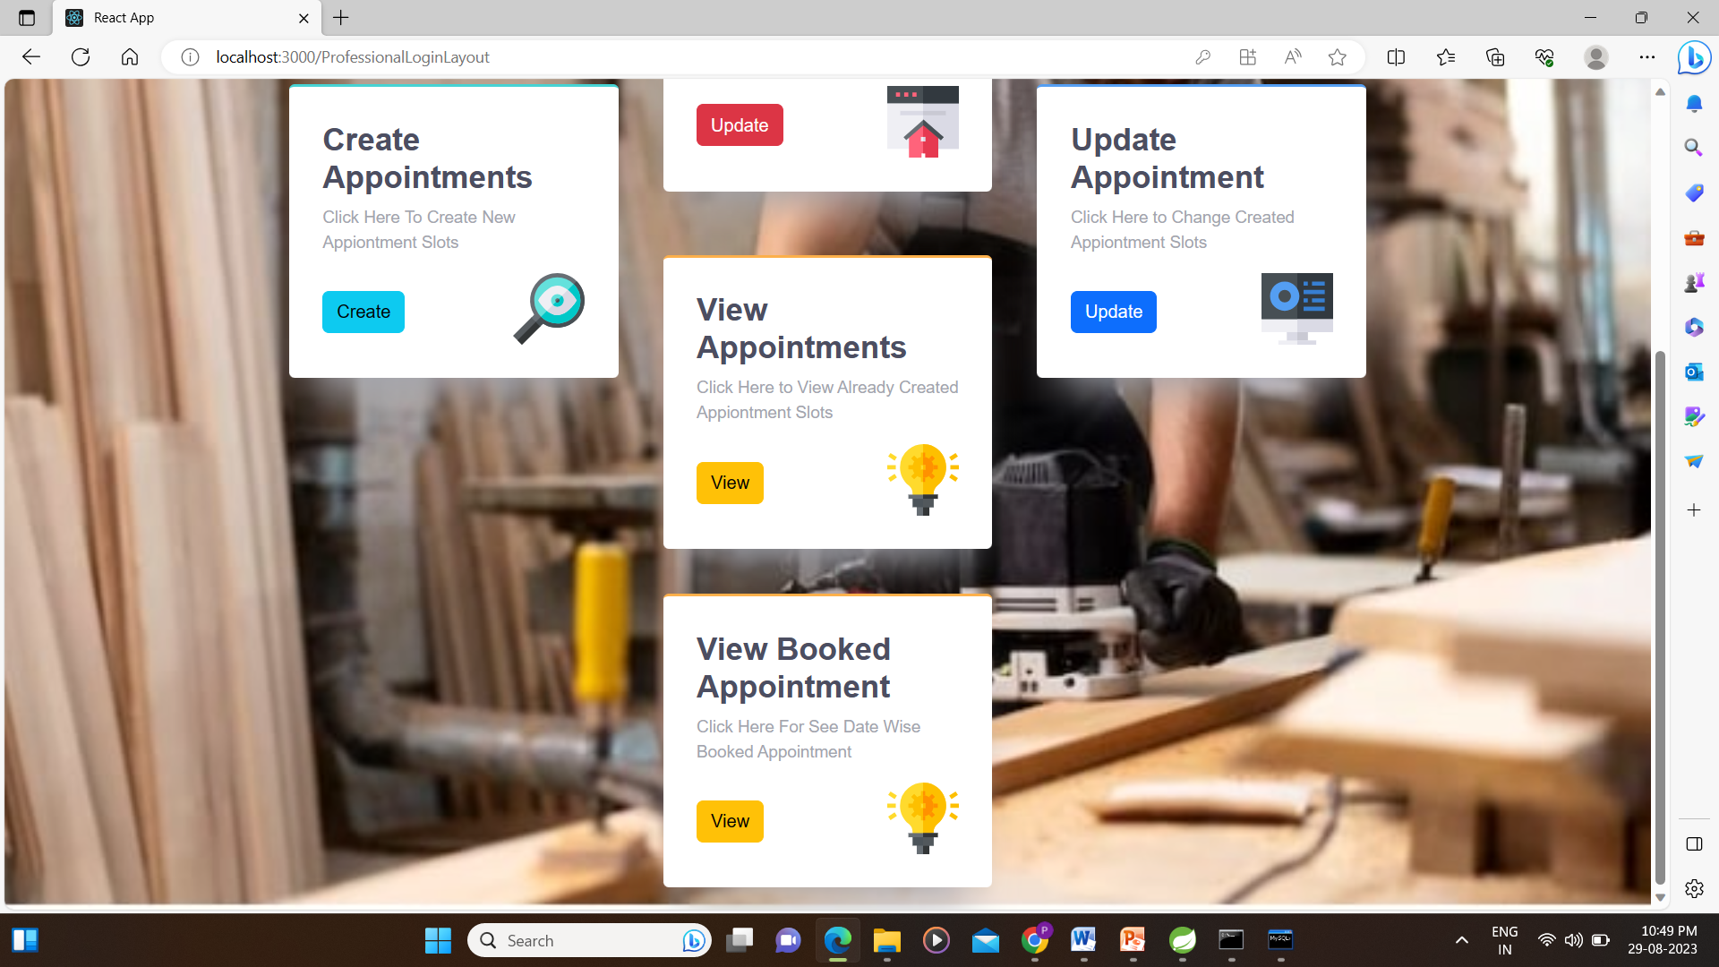

Slide 29
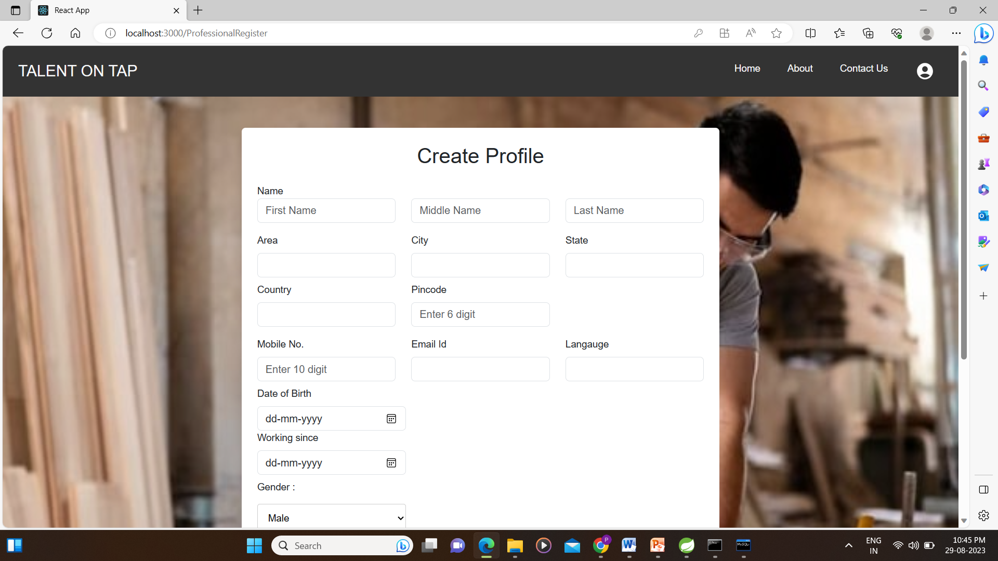
Register Professional

Slide 30
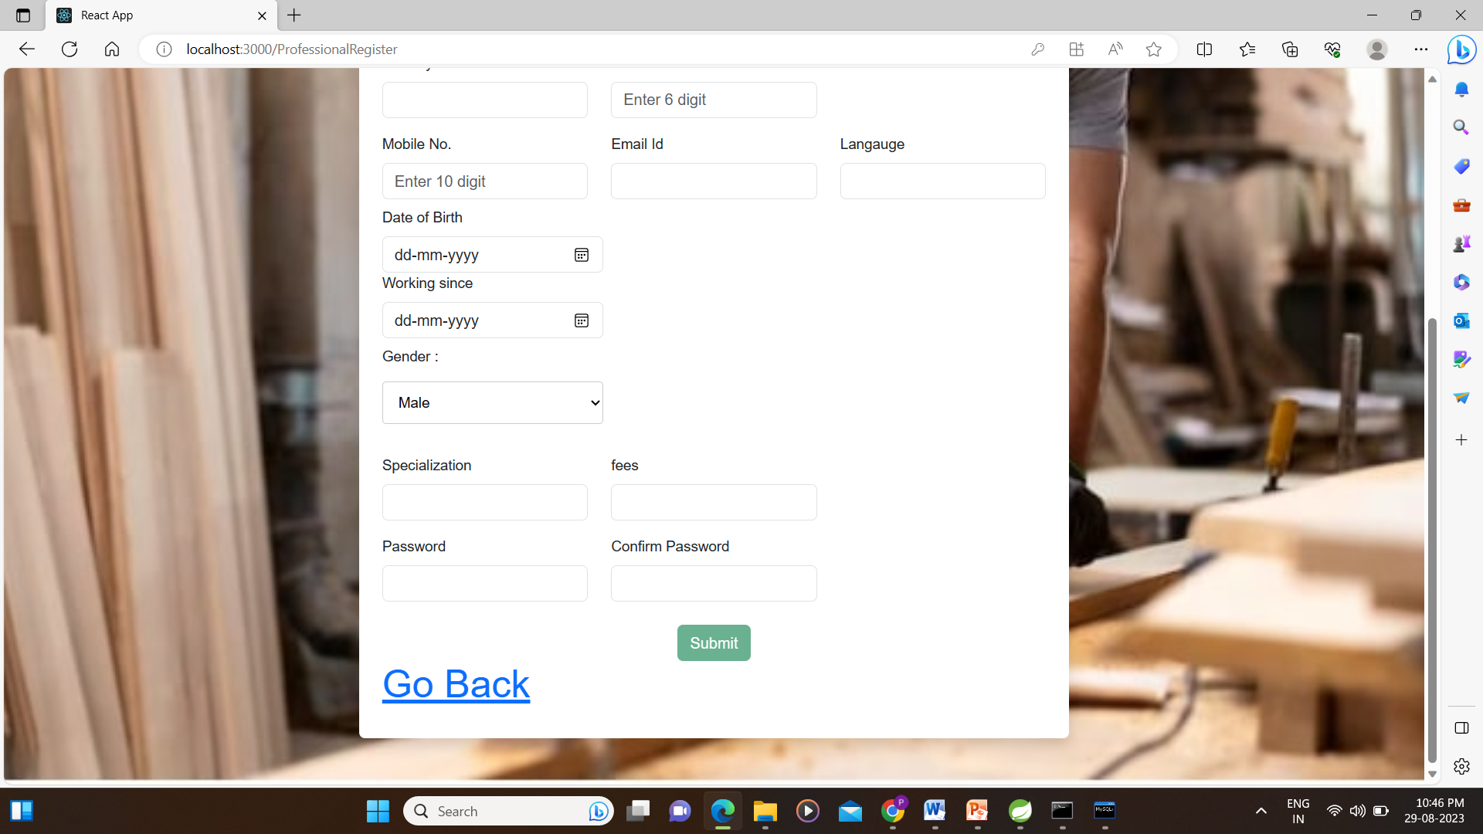

Slide 31
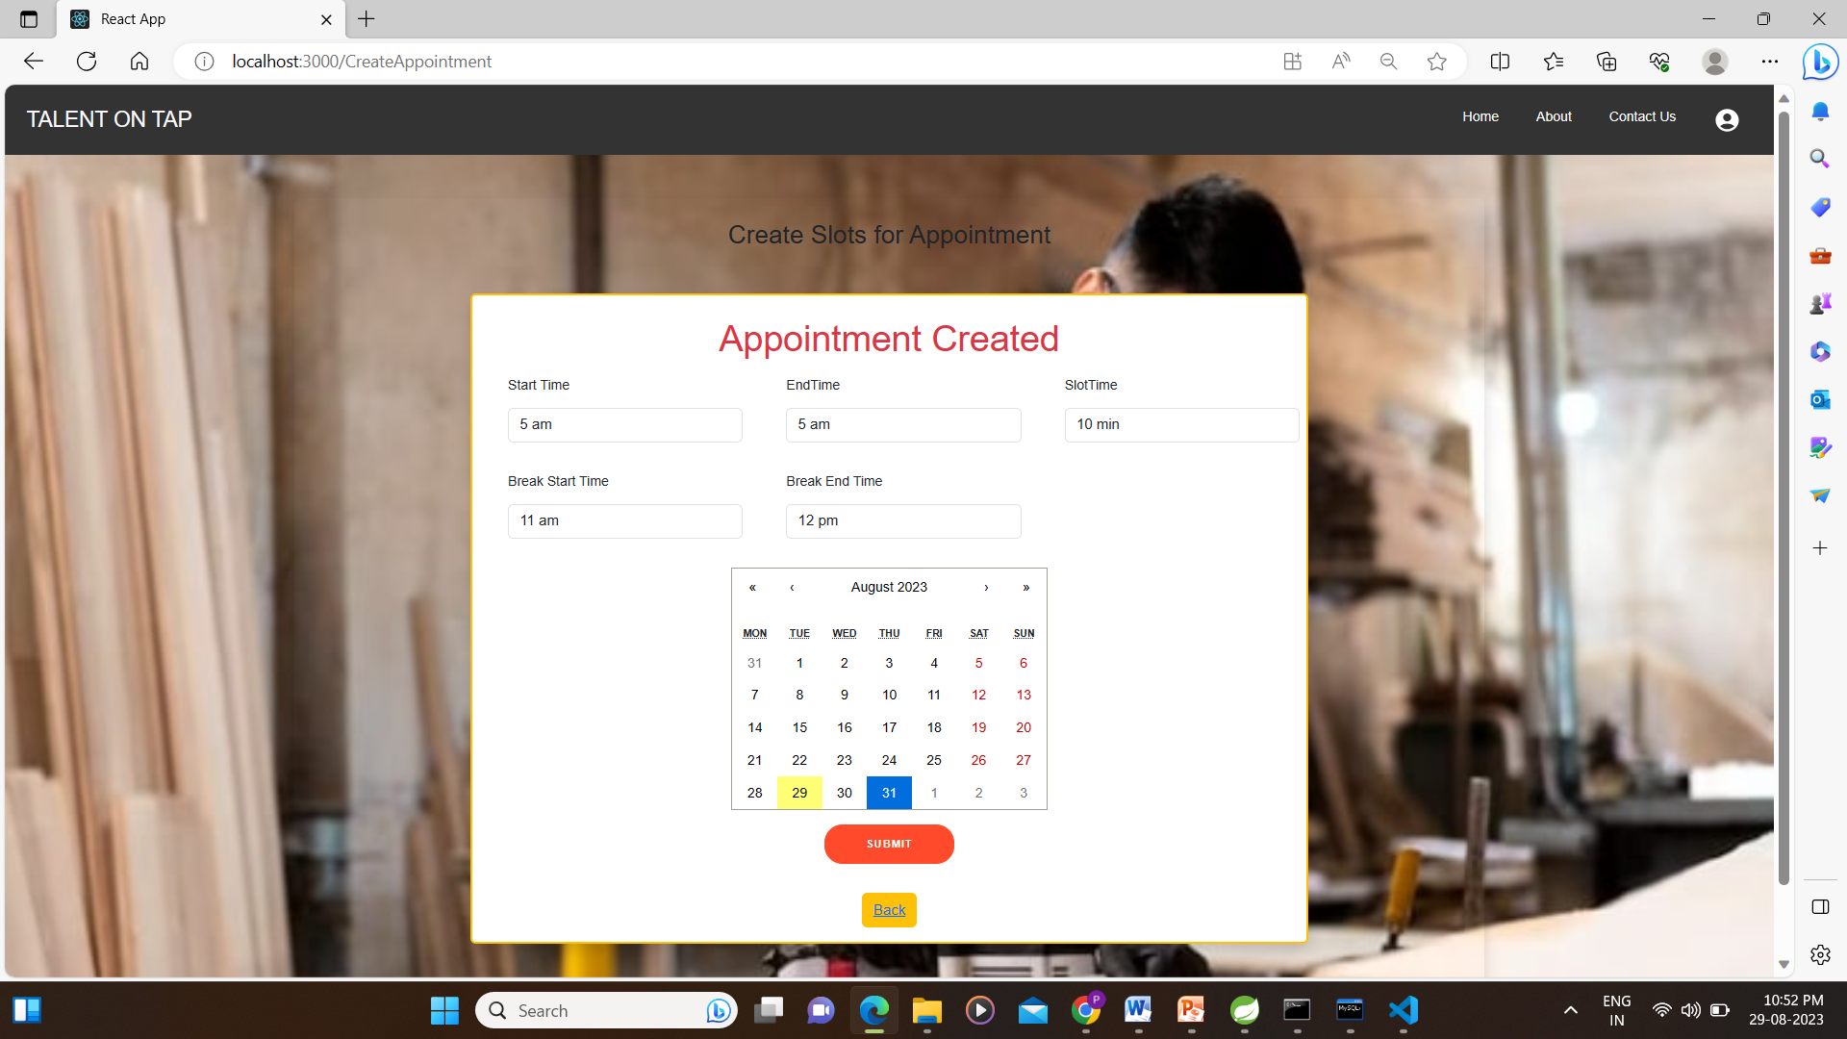
Create Appointment

Slide 32
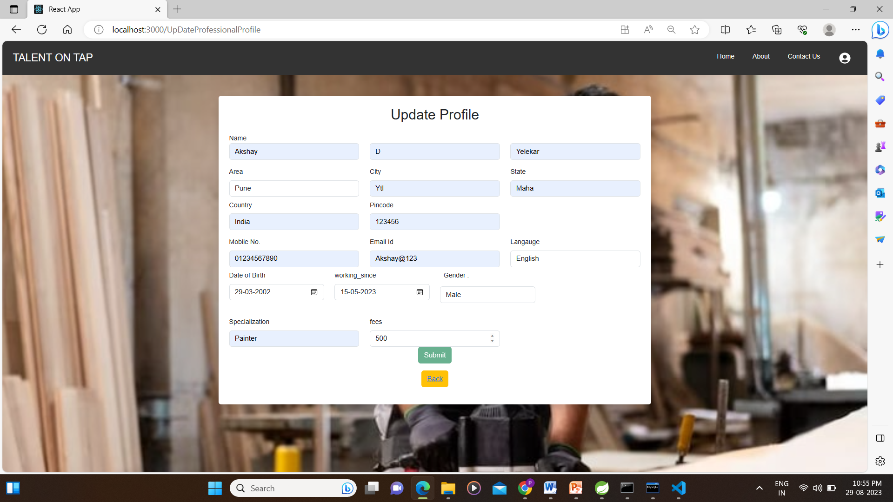
Update Profile

Slide 33
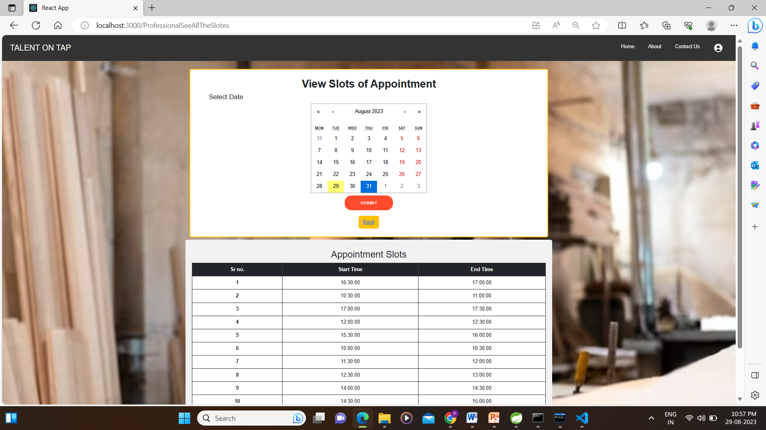
View Appointments

Slide 34
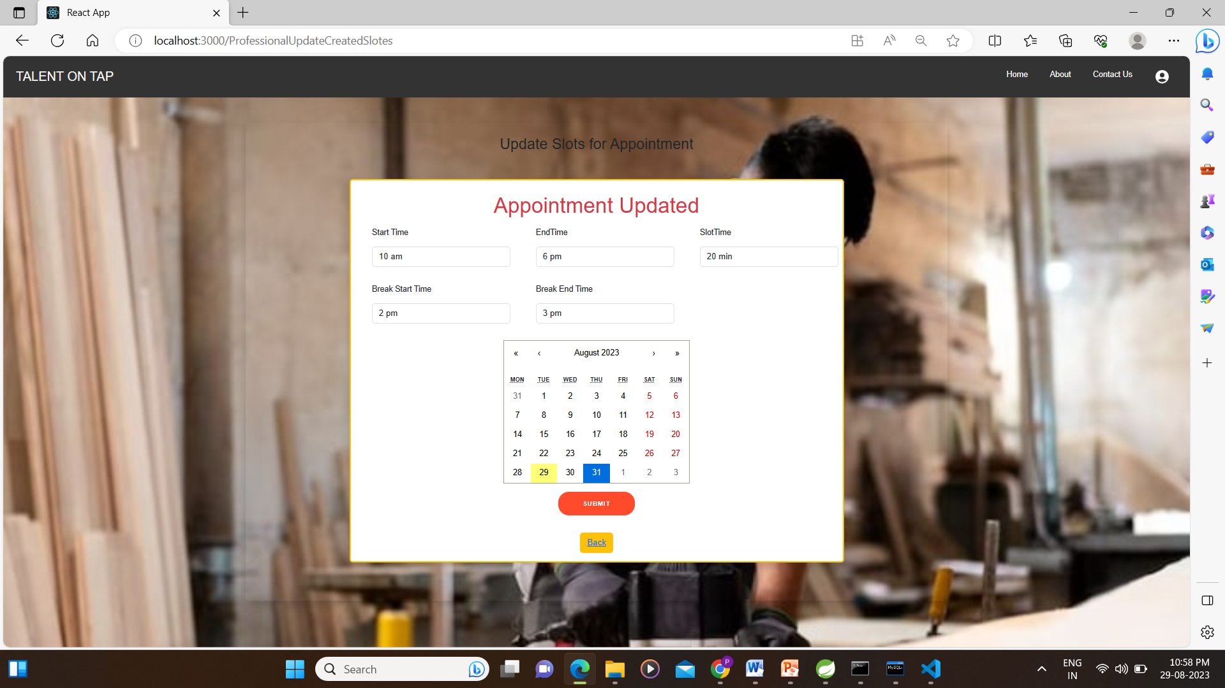
Update Appointment

Slide 35
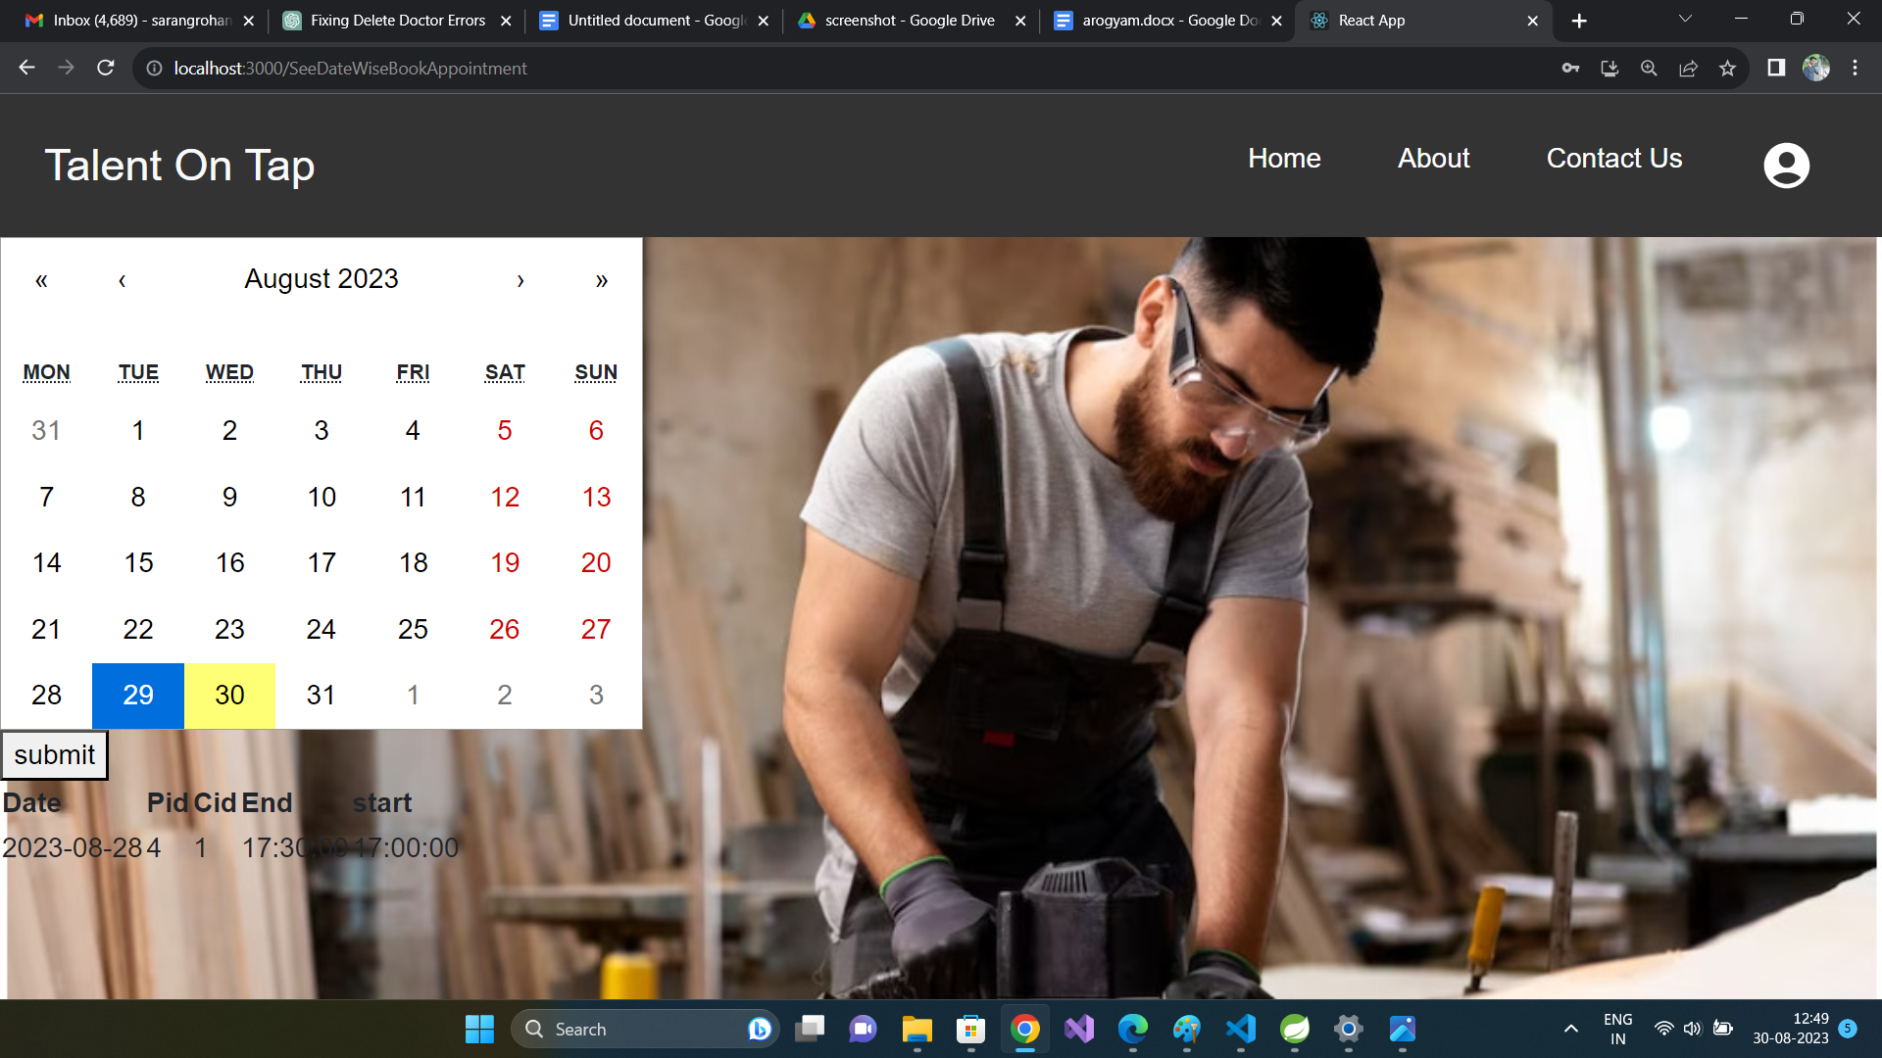
View Booked Appointment

Slide 36
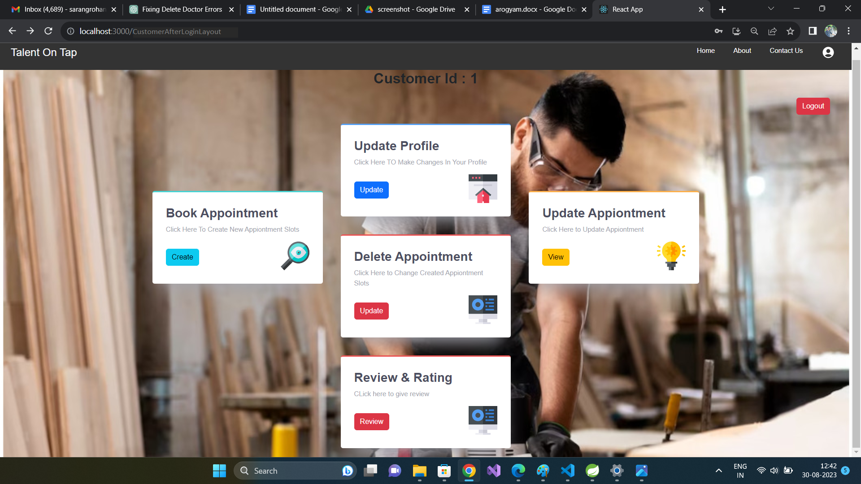
Customer :

Slide 37
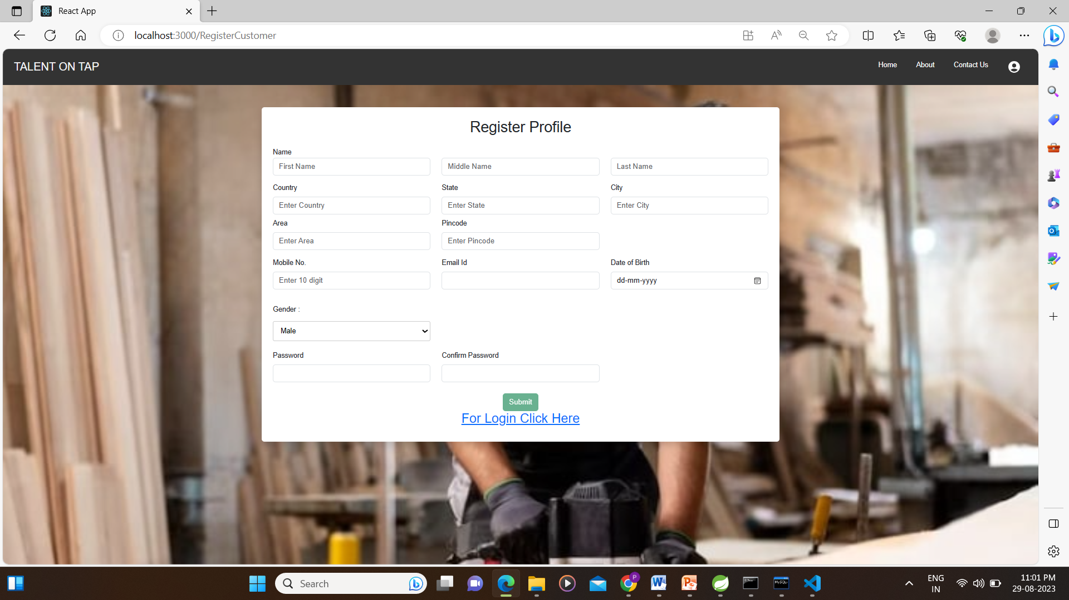
Customer Registration :

Slide 38
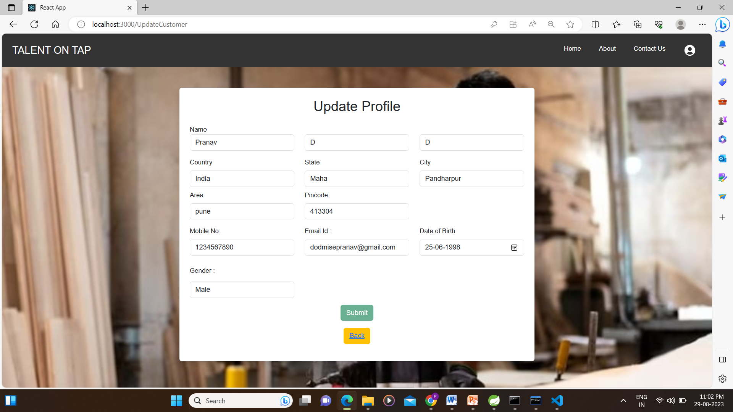
Update Profile

Slide 39
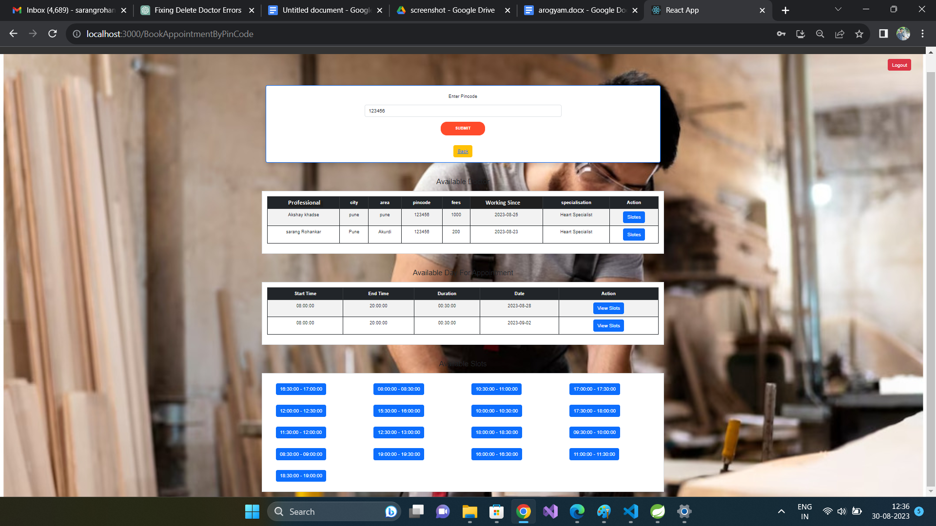
Book Appointment :

Slide 40
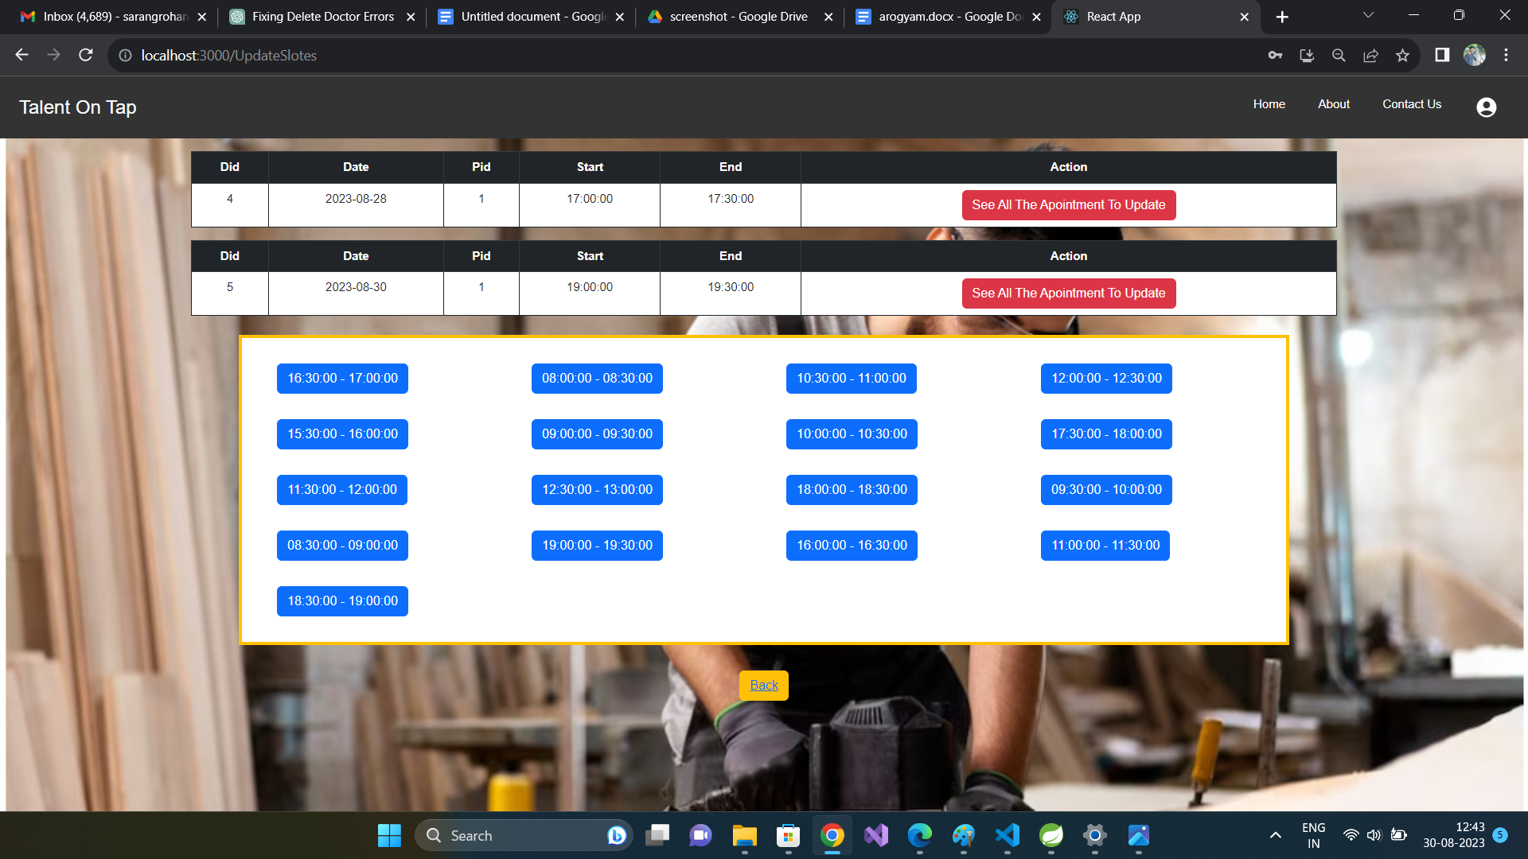
Update Appointment

Slide 41
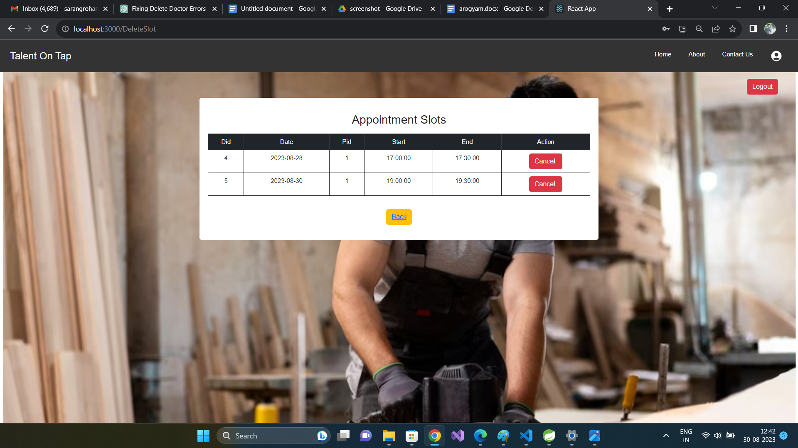
Delete Appointment

Slide 42
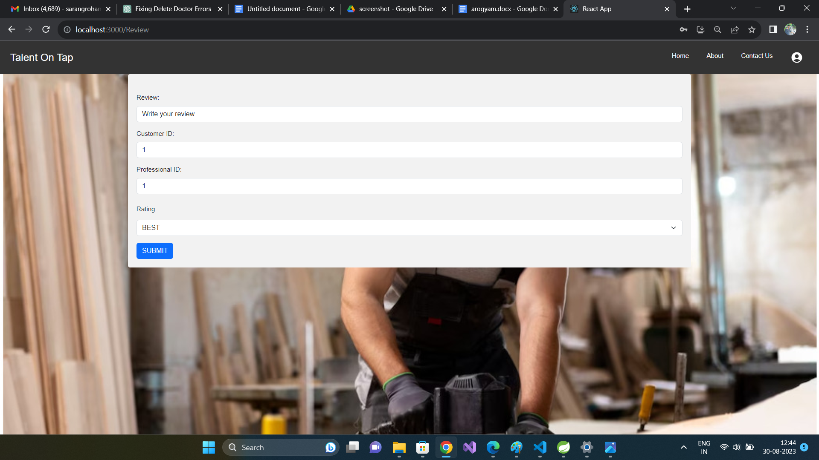
Review and Rating

